Slide 1
Data Science
My Capstone Project
By Chong
Machine Learning
Big Data
Smart Goals
Strive for Excellence

Slide 2

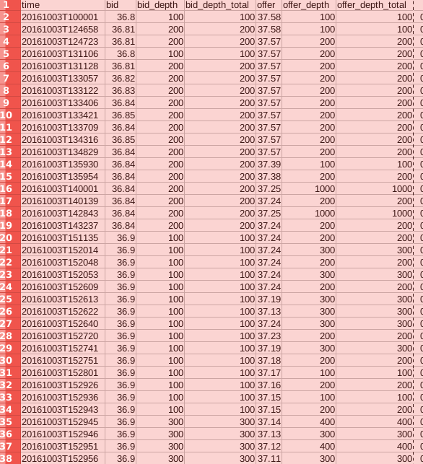
High Frequency Market Data
Bids and Offers every second
Best Level
Available from http://hopey.netfonds.no/posdump.php

Slide 3

Modelling
Get the ‘fair’ price from the bid and ask prices
Big stocks will have very small spreads, so this will be much more useful for low liquidity
Predict the next traded price

Slide 4

Modelling
Optimistically: use a recurrent neural net
This is very well suited to autoregressive time series data

Slide 5

Applications
Some financial firms need a very accurate price on small time scales – the midpoint is not enough.
Problem: the dependency is too longterm.

